Slide 1

Social Network and
Social Media Analysis
Wang Daling, Feng Shi
College of Computer Science and Engineering

Slide 2





Course Outline
Introduction
Basic Knowledge
Representation Learning
Sentiment and Emotion Analysis
Search and Recommendation

Slide 3
Representation Learning
Network Embedding
How to give the network a new representation

Slide 4
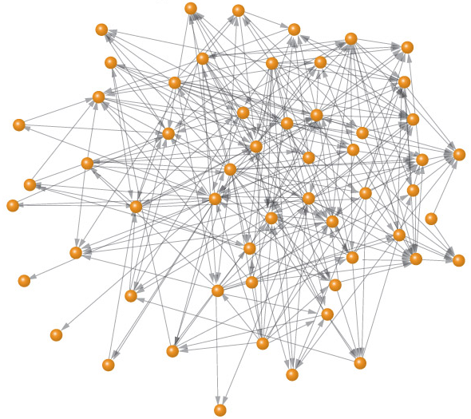
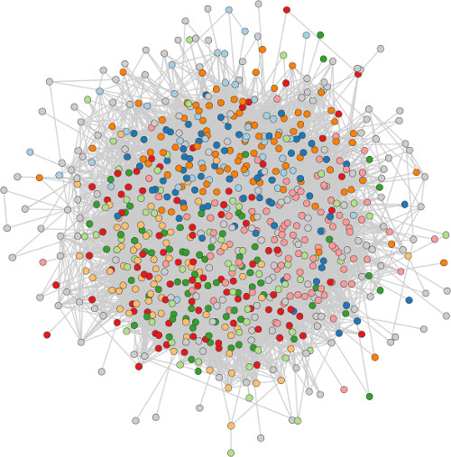
The Social Network and Graph
The social network data are typically represented in graphs
v₁
v₂
v₃
v₁
v₂
v₃
v₇
v₇
v₄
v₅
v₆
v₄
v₅
v₆
Directed Graph
Undirected Graph
Nodes and edges
Some attributes may be associated with nodes
Edges may be weighted or directional

Slide 5

Social Network Example - LBSNs
Location-Based Social Networks

Slide 6
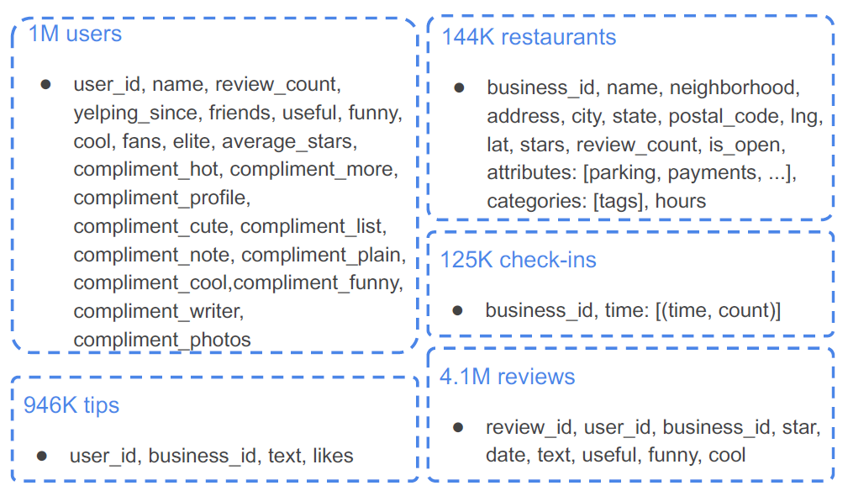
Yelp Dataset
Location-Based Social Networks

Slide 7
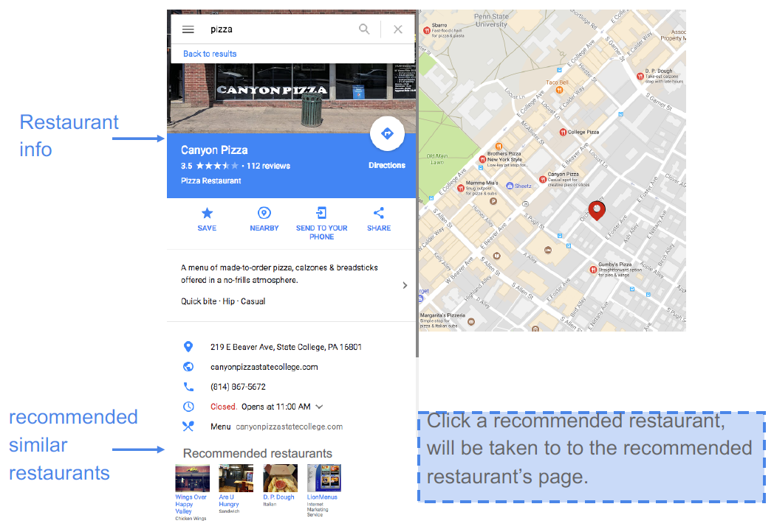
Restaurant Search Scenario

Slide 8
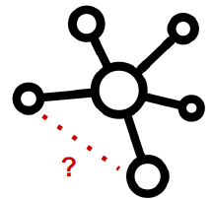
Applications
Restaurant search:
Given a restaurant, recommend similar restaurants
Formulate as k-nearest neighbor (KNN) search problem
Personalized restaurant recommendation:
Given a user, recommend restaurants she might be interested in
Formulate as a link prediction problem

Slide 9
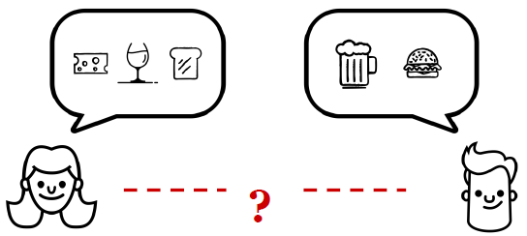
Applications (cont.)
Restaurant categorization:
Given a restaurant, classify it into categories
Formulate as a classification problem
Friendship recommendation:
Given a user, recommend new friends to her.
Formulated as a similarity search problem

Slide 10
Data Mining on Social Network
Many applications of social network are formulated as classical data mining tasks:
Node classification
Predict a type of a given node
Link prediction
Predict whether two nodes are linked
Clustering/Community detection
Identify densely linked clusters of nodes
Similarity search
How similar/relevant are two nodes?
How similar are two (sub)networks

Slide 11
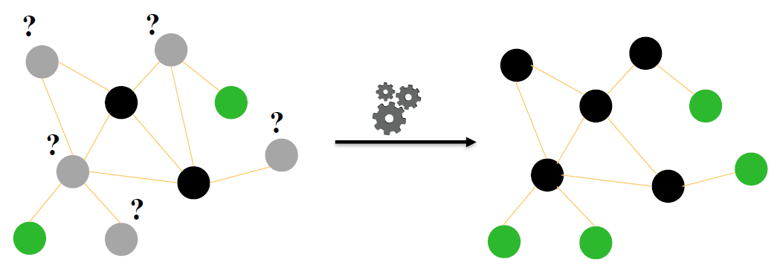
Node Classification

Slide 12
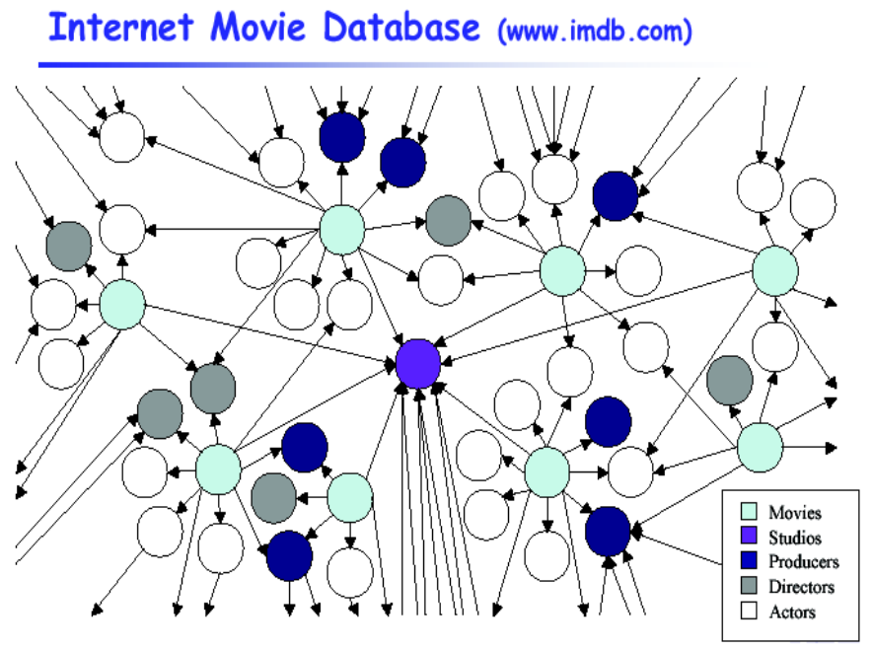
Node Classification Example

Slide 13
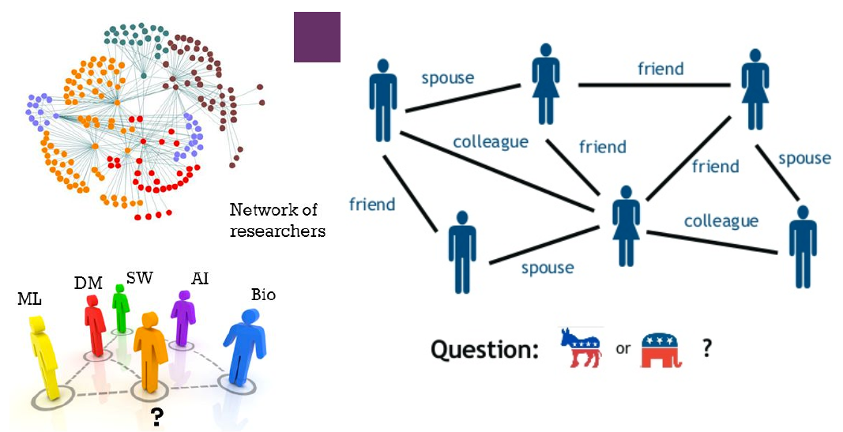
Node Classification Example

Slide 14
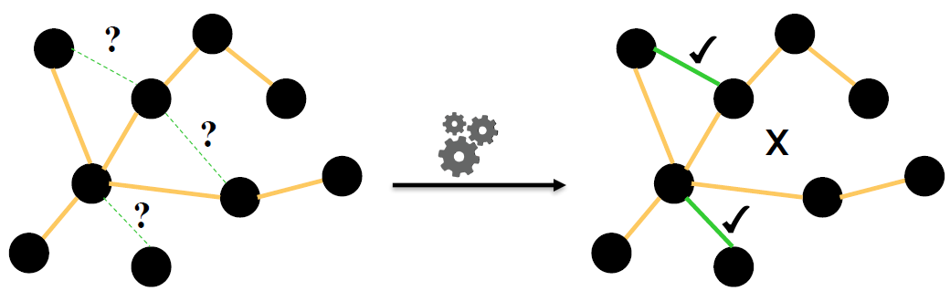
Link Prediction

Slide 15
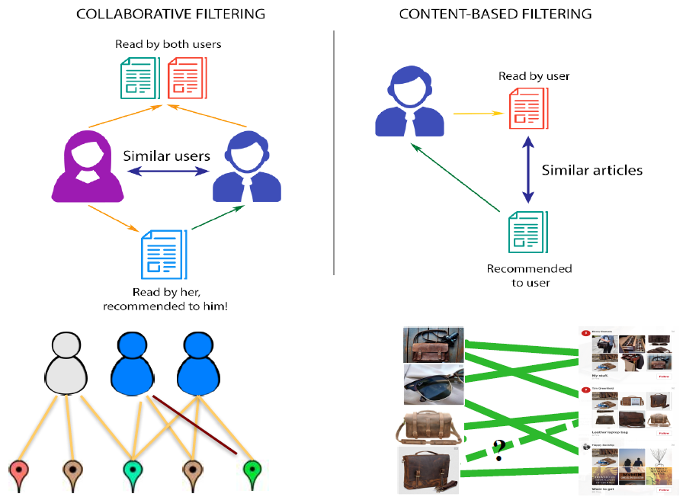
Link Prediction Example

Slide 16
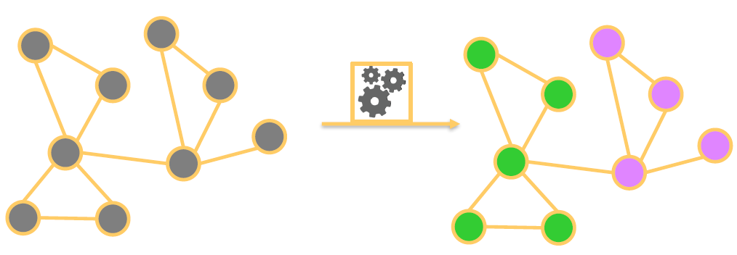
Clustering/Community Detection

Slide 17
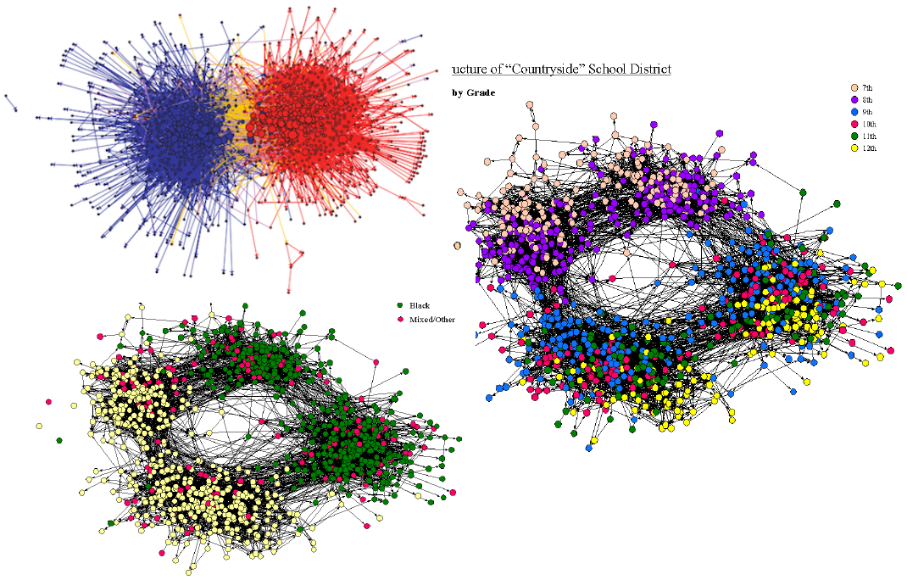
Clustering/Community Detection Example

Slide 18
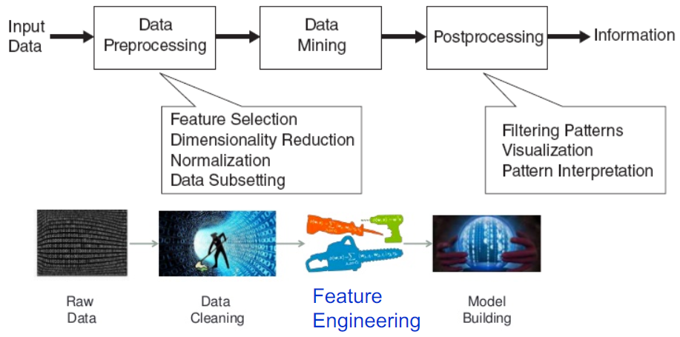
Data Mining on Social Networks
Feature engineering is essential step for data mining tasks
Feature engineering is labor-intensive and time consuming.
Many networks grow to such a scale that sophisticated network analytics become infeasible.
Open problem: Efficient and automatic feature learning.
Notes:
Feature engineering, which usually involves domain experts to manually design specific features, is labor-intensive and time consuming.

Slide 19
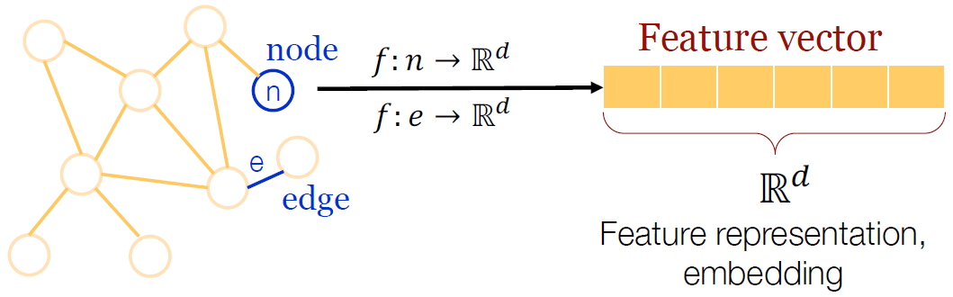
Network Embedding
Also known as Network Representation Learning
Goal: Given a network, find low-dimensional representations (i.e., embeddings) for the nodes
Similar/Relevant nodes in the graph should have embeddings close together in the latent space

Slide 20
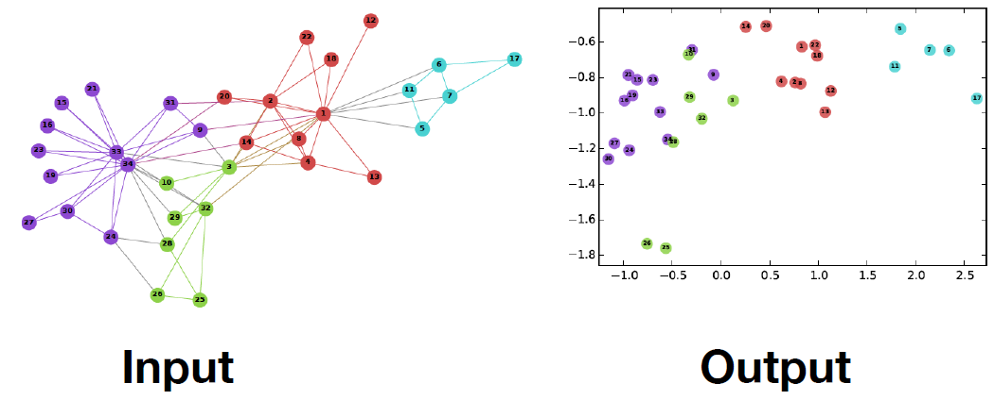
Network Embedding Example
Zachary’s Karate Club Network

Slide 21
How?
The vector space should be able to…
Goal 1 Reconstruct the original network
Goal 2
Support network inference
Network Embedding
Notes:
In order to do that, we set two goals for network embedding. The first one, is to reconstruct the original network in the embedding space, and the second one, is to support network inference in the embedding space. So we investigated network embedding methods to realize these two goals.

Slide 22
Graph Embedding v.s. Network Embedding
What’s the difference between graph embedding and network embedding?
Why graph embedding cannot fulfill the goals of network embedding?

Slide 23
Graph v.s. Network
In some sense, they are different.
Graphs exist in mathematics. (Data Structure)
Mathematical structures used to model pairwise relations between objects
Networks exist in the real world. (Data)
Social networks, logistic networks, biology networks, transaction networks, etc.
A network can be represented by a graph.
A dataset that is not a network can also be represented by a graph.

Slide 24
So many ways to define network proximities…
Co-occurrence (neighborhood)

Slide 25
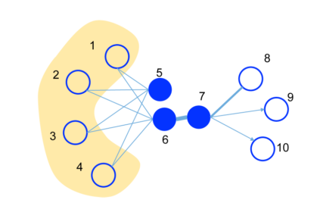
So many ways to define network proximities…
High-order proximities

Slide 26
So many ways to define network proximities…
Communities

Slide 27
So many ways to define network proximities…
Labels and attributes

Slide 28
So many ways to define network proximities…
Heterogeneous networks

Slide 29
Network Embedding
Structure-preserved network embedding
Node Neighborhood
Pair-wise Proximity
Community Structures
Heterogeneous information network embedding
Dynamic network embedding

Slide 30
Network Embedding
Structure-preserved network embedding
Node Neighborhood
Pair-wise Proximity
Community Structures
Heterogeneous information network embedding
Dynamic network embedding

Slide 31
Adjacency Matrix
matrix A
1 if v_{i} is connected to v_{j}
0 otherwise.
A{i, j}=
v₁ v₂ v₃ v₄ v₅ v₆ v₇
v₁ v₂ v₃ v₄ v₅ v₆ v₇
0 1 0 0 0 0 1
1 0 1 0 0 0 0
0 1 0 0 0 1 0
0 0 0 0 1 0 1
0 0 0 1 0 1 0
0 0 1 0 1 0 1
1 0 0 1 0 1 0
v₁
v₂
v₃
v₇
adjacency matrix
v₄
v₅
v₆

Slide 32
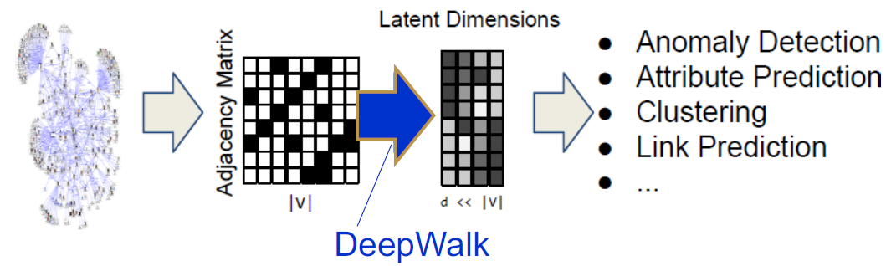
DeepWalk: online learning of social representations (KDD 2014)
Transforming the adjacency matrix of a graph into a lower dimensional latent representation
DeepWalk learns a latent representation of adjacency matrices using deep learning techniques developed for language modeling

Slide 33
DeepWalk: online learning of social representations (KDD 2014)
Idea: learn social representations of vertices in a graph through by a stream of short random walks.
Social representations are latent features of the vertices that capture neighborhood similarity and community membership.
Resort the problem to Word2Vec
Nodes <--> Words; Node sequences <--> Sentences
Generate node sequences using random walks
Connection between texts and graphs:
Words frequency in a natural language corpus follows a power law.
Vertex frequency in random walks on scale free graphs also follows a power law.

Slide 34
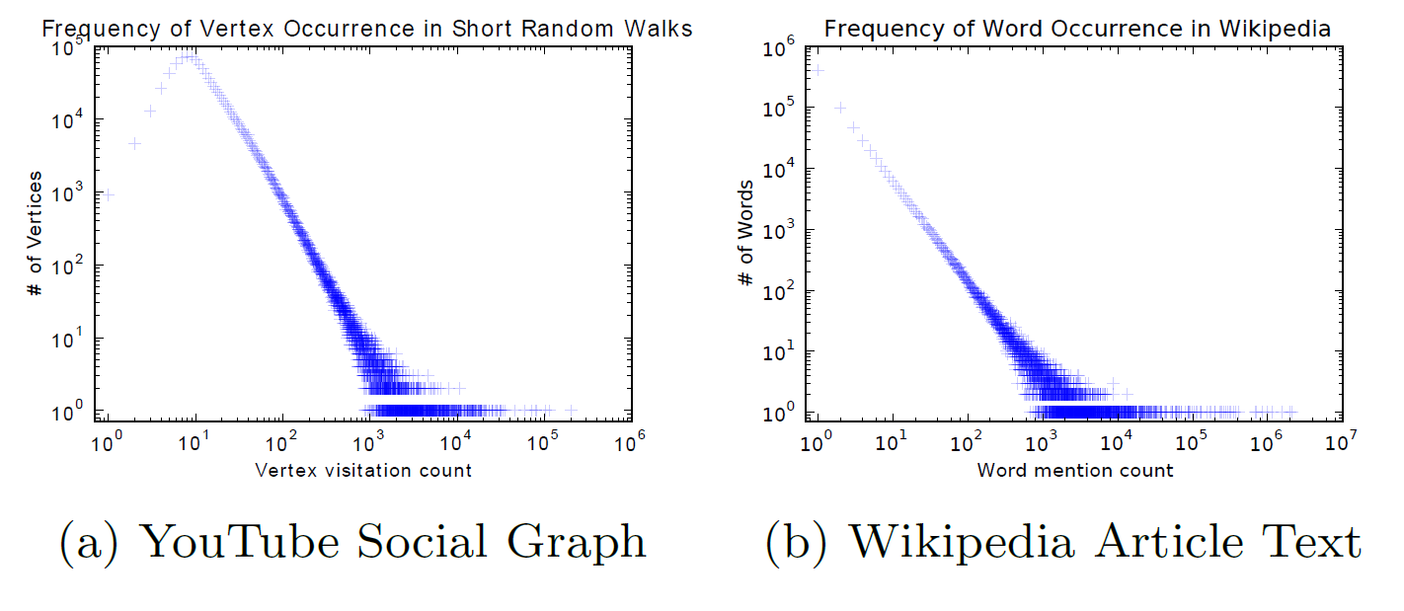
DeepWalk: online learning of social representations (KDD 2014)
Connection between texts and graphs:
Words frequency in a natural language corpus follows a power law.
Vertex frequency in random walks on scale free graphs also follows a power law.

Slide 35
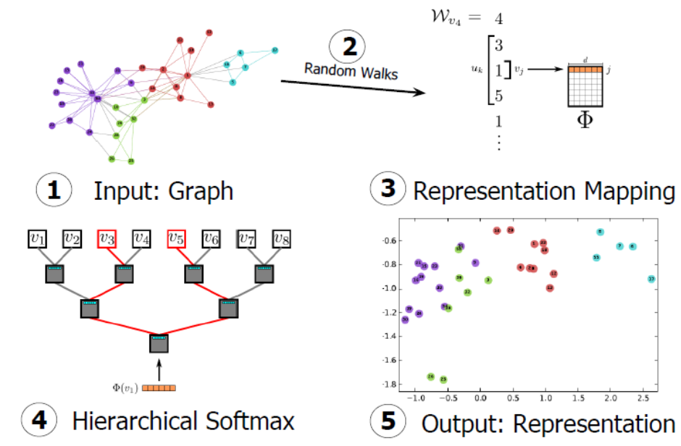
DeepWalk Framework

Slide 36
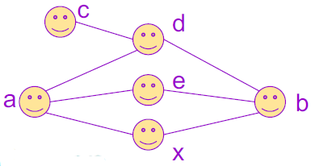
Random Walk
How to efficiently generate training data?
Positive data: node pairs within k-hop neighborhood
Negative data: node pairs not within k-hop neighborhood
DeepWalk applies a uniform random process to generate a set of random walks
c → d → a → x → b
a → e → b → d → c
A random walk captures (partial) k-hop neighborhood information between nodes
E.g., c → d → a → x → b indicates that
c, d are 1-hop neighbors
c, a are 2-hop neighbors

Slide 37
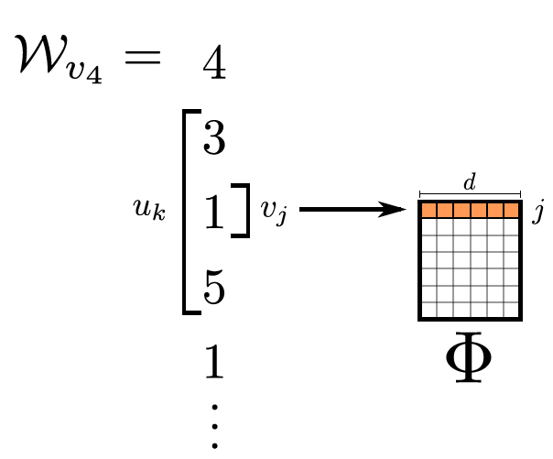
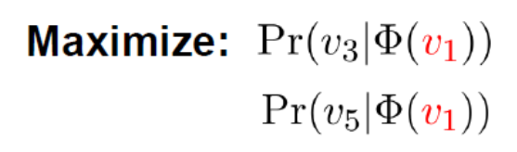
Representation Mapping
Map the vertex under focus (v₁) to its representation
Define a window size

Slide 38
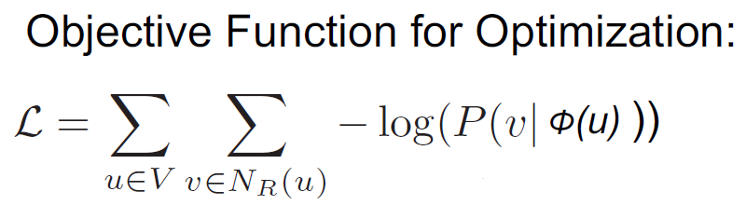
Representation Mapping by Skip-Gram
Skip-gram: The input to the model is the target node, and the output are the “context nodes”, i.e., nodes within neighborhood
v₃
Φ(v₁)
v₁
v₅

Slide 39
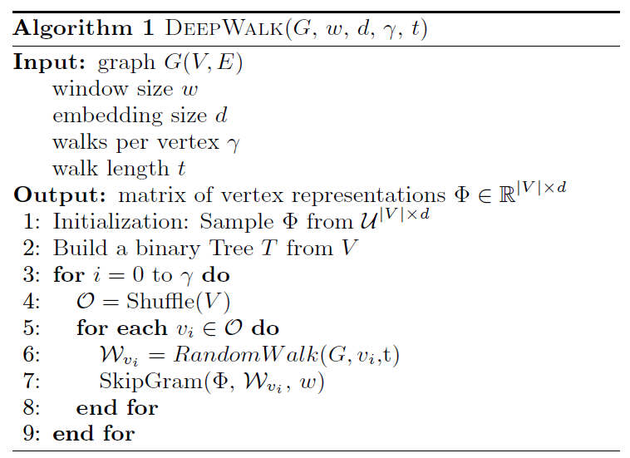
DeepWalk Algorithm

Slide 40
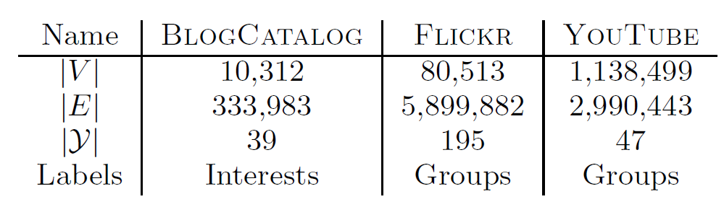
Experiment
Datasets
Application: Multi-label classification
Randomly sample a portion (TR) of the labeled nodes, and use them as training data. The rest of the nodes are used as test
Use a one-vs-rest logistic regression implemented by LibLinear extended to return the most probable labels

Slide 41
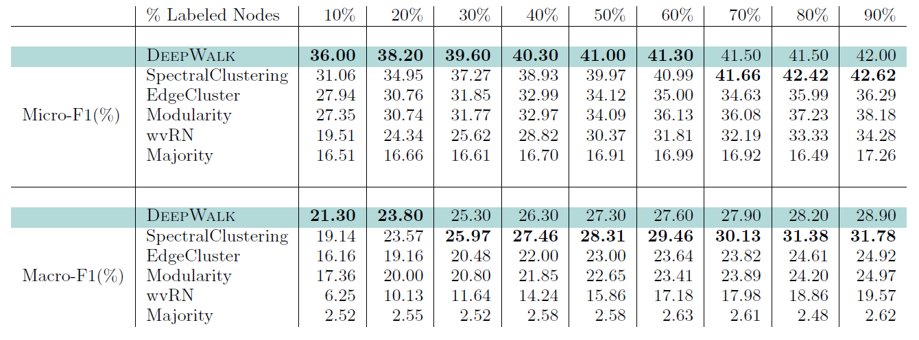
Experiment Results
BlogCatalog
This strong performance when only small fractions of the graph are labeled is a core strength of DeepWalk.

Slide 42
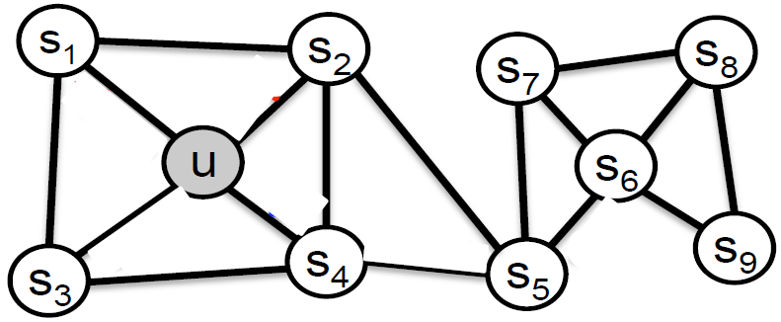
Node2Vec: Scalable Feature Learning for Networks (KDD 2016)
Nodes in the network could be characterized based on community membership or structure roles
s₁ and u (same community); s₆ and u (same role)
Aiming to learn representations capturing
the same network community
sharing similar roles

Slide 43
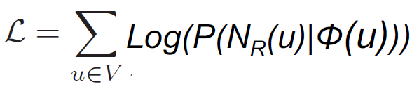
Node2Vec Model Training
Like the DeepWalk model, Node2Vec follows the Skip-Gram NN Model.
Objective function for learning:
Negative sampling is adopted for training data preparation
The focus of this work is on how to guide the sampling processing by facilitating general and flexible random walks

Slide 44
Sampling Strategies
Let the size of the neighborhood be k nodes (i.e. |N_{S}(u)| = k). Two extreme sampling strategies:
Breadth-first Sampling (BFS):
the neighborhood N_{BFS}(u) is restricted to immediate neighbors of the source u (local neighborhood).
lead to embeddings that correspond closely to structural equivalence (roles)
Depth-first Sampling (DFS):
the neighborhood N_{DFS}(u) consists of nodes sequentially sampled at increasing distances from the source node u.
aiming to produce embeddings corresponding to homophily (communities membership)
Notes:
结构等价
网络同质性

Slide 45
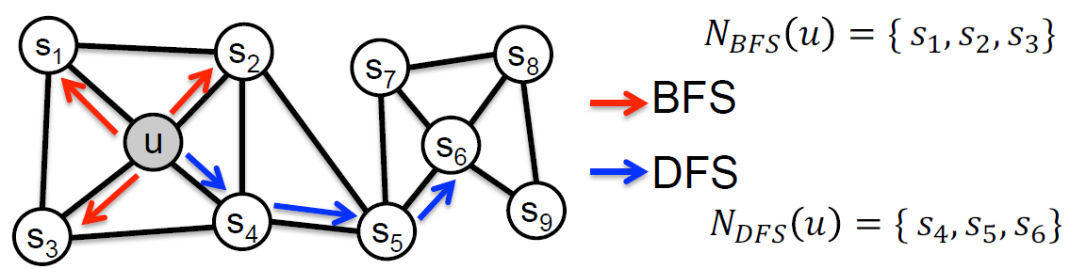
Node2vec Random Walk
Two views of neighborhoods:
Local microscopic view and Global macroscopic view
Between the two extremes, there are many combined ways (random walk strategies) to explore the network neighborhood
Idea: Explore biased random walks by trading off between local and global views of the network.
Notes:
Local microscopic view and Global macroscopic view 局部微观与全局宏观
中国与非洲国家，全局宏观

Slide 46
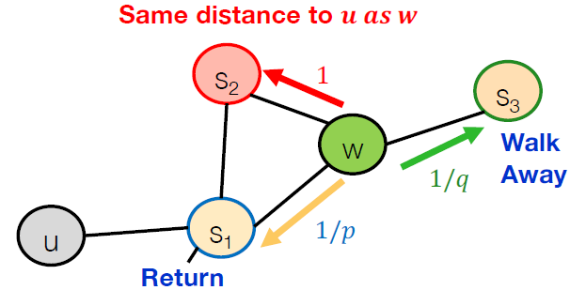
Search Bias α
Node2Vec visits the next node based on (edge weight* α)
Let t be the node visited right before at the current node w, and x be a candidate node to visit next
α = 1/p if d(t, x)=0
α = 1 if d(t, x)=1
α = 1/q if d(t, x)=2
Parameters p and q
control how fast the
walk explores and leaves
the neighborhood of starting node u.

Slide 47
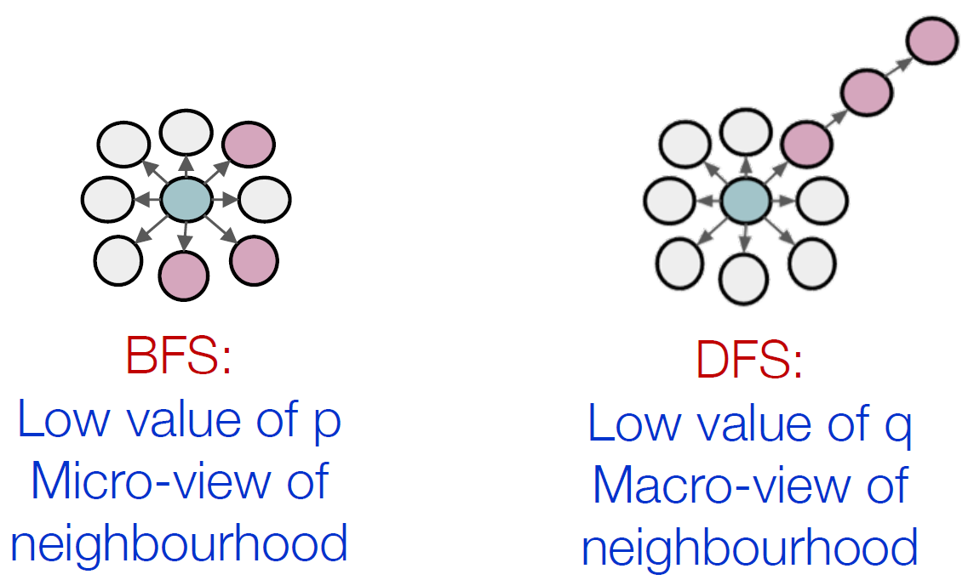
BSF vs. DFS

Slide 48
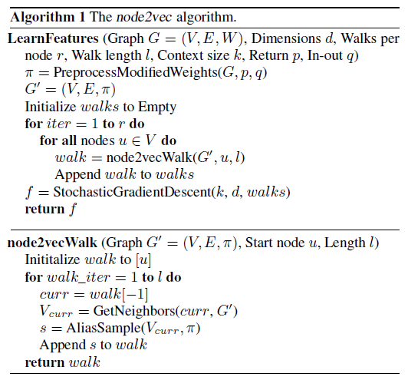
Node2Vec Algorithm

Slide 49
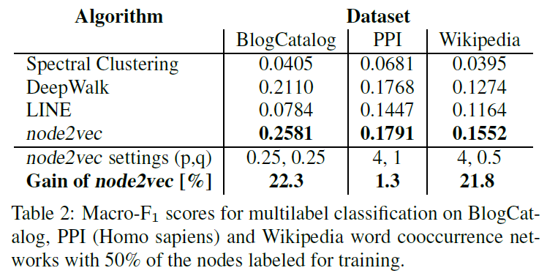
Experiment
Multi-label classification

Slide 50
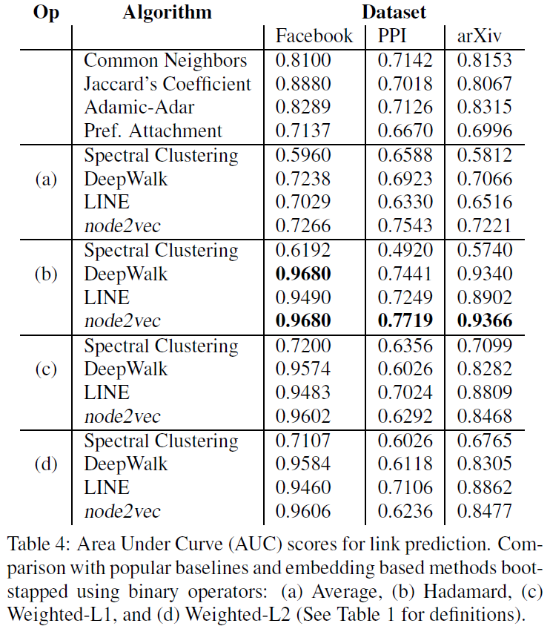
Experiment
Link prediction

Slide 51
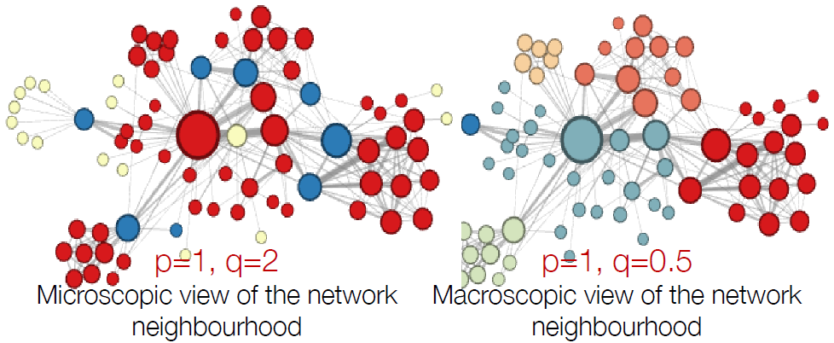
Case Study: Les Misérables

Slide 52
Node2Vec Advantages
Expressivity: Flexible stochastic definition of node similarity that incorporates both local and higher-order neighborhood information.
Efficiency: Do not need to consider all node pairs when training; only need to consider pairs that co-occur on random walks.

Slide 53
Network Embedding
Structure-preserved network embedding
Node Neighborhood
Pair-wise Proximity
Community Structures
Heterogeneous information network embedding
Dynamic network embedding

Slide 54
LINE: Large-scale Information Network Embedding (WWW 2015)
DeepWalk lacks a clear objective function tailored for network embedding
The neighborhood relationship has a coarse-granularity
DFS-based random walk is adopted
LINE: able to scale to very large, arbitrary types of networks: undirected, directed and/or weighted.
The model optimizes clear objectives which preserves the local and global network structures, correspondingly.
Two different fine-granularity relationships with proper semantics are identified
BFS-based approach is adopted

Slide 55
Local & Global Structures
Local network structures are represented by the observed links in the networks,
Captured by the first-order proximity
In the real world, the observed first-order proximity data is not sufficient for preserving the global network structures
In a real-world network, many legitimate links are actually not observed
Neighborhood structures of the nodes with shared neighbors are likely to be similar
Explore the second-order proximity

Slide 56
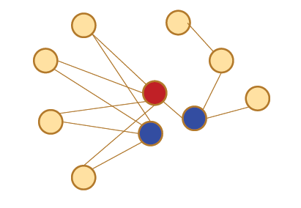
Relationship between nodes
Which blue nodes should be placed closer to the red nodes in the latent feature space?

Slide 57
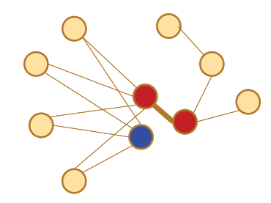
First-Order Proximity
The local pair-wise proximity determined by the observed links

Slide 58
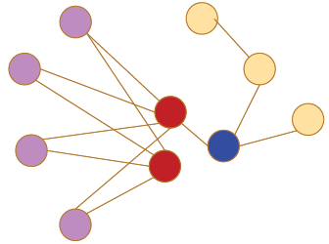
Second-Order Proximity
A pair of nodes with zero first-order proximity may be intrinsically very similar to each other.
The second-order proximity determined by the shared neighborhoods of network nodes
Two nodes share a lot of common neighbors have a high 2nd-order proximity

Slide 59
LINE Models
LINE treats two different proximities between nodes separately, using two different models
Generate two separate latent vectors and then concatenate them into one long vector.
The 1st-order proximity models two nodes by their observed co-occurrance
The 2nd-order proximity assumes that nodes sharing many common nodes are similar.
Captured by 2-hop neighborhood
Each node also serves as “context” (i.e., neighbor) of other nodes. Thus, nodes with similar distributions over the “contexts” are assumed to be similar

Slide 60
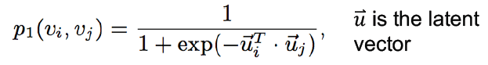
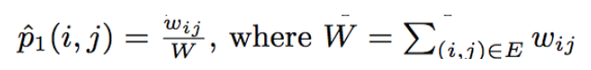
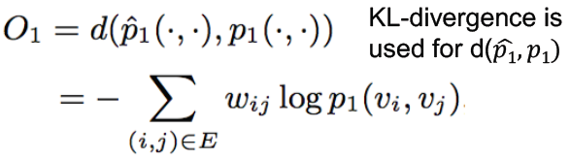
LINE with 1st-order Proximity
Distribution of joint probability estimated by model
Distribution of joint probability obtained empirically
Objective Function:
Notes:
为了模拟一阶相似度，对于每个无向边（i，j），定义顶点v_{i}和v_{j}之间的联合概率如下：（sigmoid function，向量越接近，点积越大，联合概率越大）其中，W=Σw_{i}。得到了另一个分布。
经验概率可以定义为：（两点之间边的权值越大，经验概率越大） 其中d（·，·）是两个分布之间的距离。 选择最小化两个概率分布的KL散度，用KL散度代替d（·，·）并省略一些常数，得到：

Slide 61
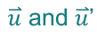
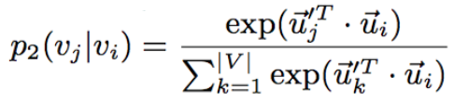
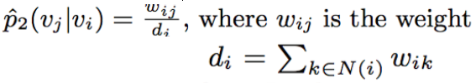
LINE with 2nd-order Proximity
Each node plays two roles: the node itself and a specific “context” of other nodes
are the latent vectors of these two roles
Probability of “context” v_{j} generated by vertex v_{i} estimated by model
Probability of “context” v_{j} generated by vertex v_{i} estimated empirically
Notes:
其中，|V|是网络中顶点的数目。方程定义了一个条件分布p2（·| vi），表明了低维向量空间中，各个点是顶点v_{i}的邻居的概率。
经验概率（网络中，各个点是v_{i}的邻居的概率）
w_{ij}是边（i，j）的权重，d_{i}是顶点i的出度，d_{i}=Σ_{k∈N(i)} w_{ik}。

Slide 62
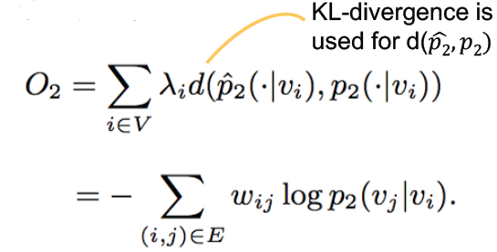
LINE with 2nd-order Proximity
Objective Function:
Notes:
因为网络中顶点的重要性不同，引入λ_{i}表示网络中顶点的重要程度。
为简单起见，将λ_{i}设置为顶点i的度数，即λi= di。

Slide 63
Edge Sampling
Use negative sampling to improve computational efficiency
Instead of using random walk to prepare training data, LINE samples edges based the sampling probabilities proportional to their edge weights
For each positive edge, k negative edges are randomly generated.

Slide 64
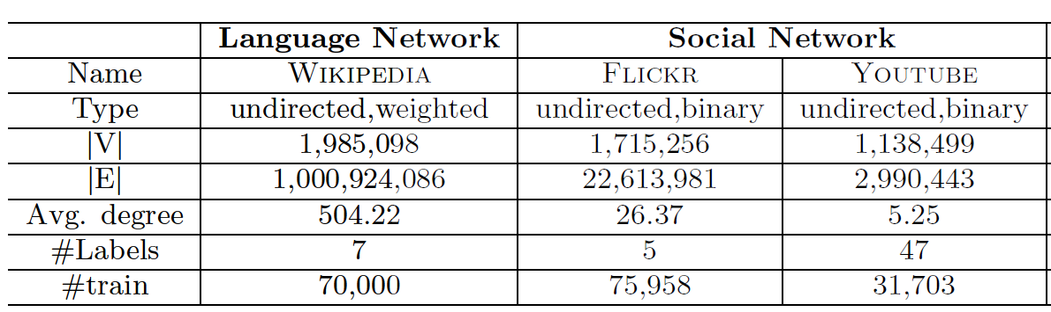
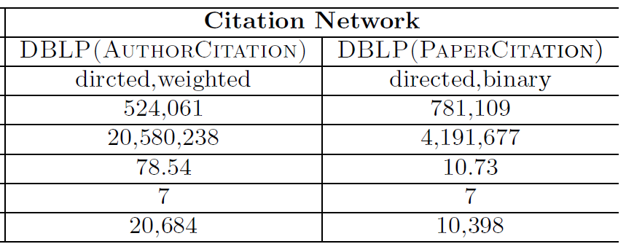
Experiment

Slide 65
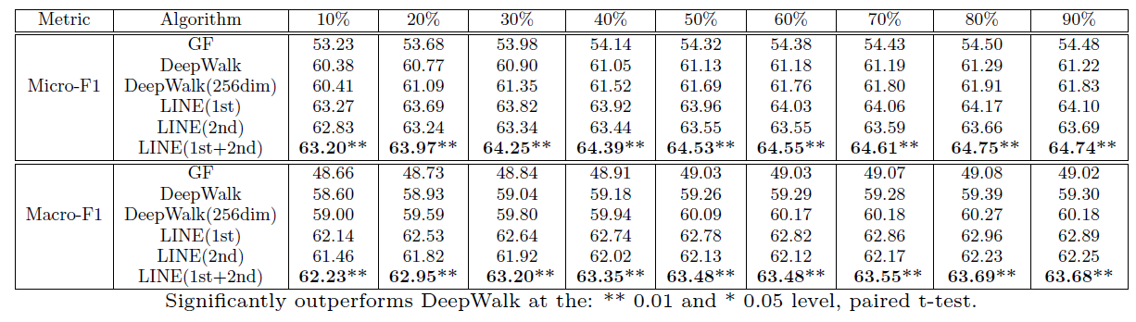
Experiment Results

Slide 66
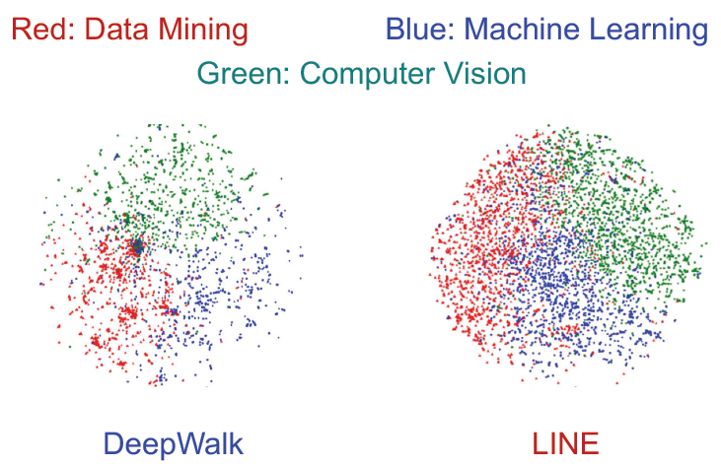
Case Study: Co-Author Network

Slide 67
Network Embedding
Structure-preserved network embedding
Node Neighborhood
Pair-wise Proximity
Community Structures
Heterogeneous information network embedding
Dynamic network embedding

Slide 68

Community Preserving Network Embedding (AAAI 2017)
second-order
proximity
first-order
proximity
Network structure
Microscopic structure
Pairwise structure: first-order and second-order proximities
Mesoscopic structure
community
structure
Community structure: proximities among a group
important features of network: reveal organizational structure
higher level structural constraints on node representations
Notes:
介观结构

Slide 69

Community-preserving: M-NMF
Modularized NMF
Preserving the first and second order proximity
Identifying the community structure
Linking up the node embedding with the community structure
Notes:
利用节点表示和社区结构之间的一致关系（consensus relationship）， 联合优化基于非负矩阵分解的表示学习模型和基于模块化的社区发现模型， 这样就可以在节点表示中同时保存了微观网络结构和介观社区结构。
具体来说，对于微观结构（节点对相似性），本文使用矩阵分解来融合节点的一节相似性和二阶相似性；对于介观社区结构，通过模块度约束项来检测社区。因此，上面的两项可以通过节点的表示和基于辅助社区表示矩阵社区结构之间的一致关系来联合优化。同时，本文给出了乘法更新策略，保证了再推导参数的时候的正确性和收敛性。
其中tr()tr()表示矩阵的迹（主对角线元素和），HH是社区成员指标器，H∈Rn×kH∈Rn×k，每行表示一个节点所属社区的one-hot编码。

Slide 70

Community-preserving: M-NMF
Evaluation – node clustering
Achieve the best results on eight of nine networks
Notes:
数据集中节点个数在几千个左右

Slide 71
Network Embedding
Structure-preserved network embedding
Node Neighborhood
Pair-wise Proximity
Community Structures
Heterogeneous information network embedding
Dynamic network embedding

Slide 72

Heterogeneous Information Networks
Heterogeneous Information Networks (HIN, or heterogeneous graph) contain multiple object types and/or multiple link types.

Slide 73

Examples in the Literature
Heterogeneous Information Networks (HIN, or heterogeneous graph) contain multiple object types and/or multiple link types.

Slide 74
PTE: Predictive Text Embedding through Large-scale Heterogeneous Text Networks (KDD 2015)
Learning a meaningful and effective representation of text, e.g., for words and documents, is critical to text classification, clustering and retrieval.
Text embedding models, based on unsupervised learning process, are general enough for a variety of tasks, but fall short in comparison with supervised approach using labeled information when targeting on specific tasks.
Predictive text embedding (PTE) extends an unsupervised information network embedding, LINE, to learn a low dimensional embedding for words through a heterogeneous text network.
Targeting specifically on text classification applications
Semi-supervised using both labeled & unlabeled info.

Slide 75


Heterogeneous Text Networks
The network encodes different levels of cooccurrence information between words and words, words and documents, and words and labels
Word-Word Network
The weight w_{ij} of an edge denotes the number of times two words co-occur in the context windows of a give size.

Slide 76


Word-Document Network
Word-Document network is a bipartite network of words and documents
The weight w_{ij} denotes the number of times word v_{i} appears in document d_{j} .

Slide 77

Word-Label Network
Word-Label network captures category-level word co-occurrences
The weight w_{ij} denotes the frequency of word v_{i} being associated with class c_{j}, i.e., the number of times v_{i} appearing in documents tagged as c_{j}

Slide 78
Predictive Text Embedding
PTE learns vector representations of words by embedding the heterogeneous text networks constructed from free text into a low dimensional space, and then infer text embeddings based on the learned word vectors

Slide 79

Bipartite Network Embedding
The conditional probability can be estimated empirically as:
Objective function for Bipartite network

Slide 80

Objective and Training
PTE adopts the following objective function
Training is done jointly using three networks together

Slide 81

Experiment Results
Notes:
In the classification phase, we use the one-vs-rest logistic regression model in the LibLinear package.

Slide 82

Experiment Results

Slide 83
Network Embedding
Structure-preserved network embedding
Node Neighborhood
Pair-wise Proximity
Community Structures
Heterogeneous information network embedding
Dynamic network embedding

Slide 84

Dynamic Networks
Networks are dynamic in nature
New (old) nodes are added (deleted)
New users, products, etc.
The edges between nodes evolve over time
Users add or delete friends in social networks, or neurons establish new connections in brain networks.
Efficiently incorporate the dynamic changes when networks evolve

Slide 85
Key problems in dynamic network embedding
I : Out-of-sample nodes
II : Incremental edges
III: Aggregated error
IV: Scalable optimization

Slide 86
Network Embedding Trends
Graph Neural Networks

Slide 87
Embedding methods
Shadow models
Factorization-based approaches, e.g., Laplacian eigenmaps
Random walk approaches, e.g., DeepWalk and node2vec
Deep models
Autoencoder approaches, e.g., DNGR and SDNE
Graph convolution network, e.g., GCN, GraphSage
Graph attention network, e.g., GAT

Slide 88
New Challenges
How to extend ConvNets to graph structured data ?
Assumption :
Graph structured data is compositional :
Locally stationary and manifest hierarchical structures.
How to define compositionality on graphs ? (convolution/pooling on graphs)
How to make them fast? (linear complexity)

Slide 89

Two Types of GCN
Slides from Xavier Bresson
Notes:
图谱卷积，在傅里叶域进行卷积变换，有相关理论支持
空间域卷积，直接在图上进行卷积，更像是一种trick

Slide 90
GNN Applications
Network embedding
Node classification
Community detection
Link prediction
NLP
Semantic Role Labeling, NMT
Text Classification, Extraction
Knowledge Graphs
Computer vision

Slide 91

Text Classification, Extraction

Slide 92
Conclusion
Huge and complex social networks
Embed the nodes, edges and attributes into distributed representations
Many potential applications

Slide 93
References
Peng Cui, Xiao Wang, Jian Pei, Wenwu Zhu: A Survey on Network Embedding. IEEE Trans. Knowl. Data Eng. 31(5): 833-852 (2019)
HongYun Cai, Vincent W. Zheng, Kevin Chen-Chuan Chang: A Comprehensive Survey of Graph Embedding: Problems, Techniques, and Applications. IEEE Trans. Knowl. Data Eng. 30(9): 1616-1637 (2018)
Quan Wang, Zhendong Mao, Bin Wang, Li Guo: Knowledge Graph Embedding: A Survey of Approaches and Applications. IEEE Trans. Knowl. Data Eng. 29(12): 2724-2743 (2017)
Chuan Shi, Yitong Li, Jiawei Zhang, Yizhou Sun, Philip S. Yu. A survey on Heterogeneous Information Network Analysis IEEE Trans. Knowl. Data Eng. 29(1), 17-37, 2017

Slide 94

Let’s continue to:
Sentiment Analysis

